Slide 1
Digital Product design
Lecture 2: Ideation and Hypothesis Development
Alex Moehring

Slide 2
Outline
Theory of ideation + opportunity development
Ideation & refinement process
Project matching + ideation
Goal is to have a team, product / problem, and ideas to improve

Slide 3
Opportunity identification
* Ulrich & Eppinger Chapter 3

Slide 4
What is an Opportunity?
An opportunity is an idea for a new product
A rough match for a customer need and a possible solution
A hypothesis about how value may be created
A simple taxonomy of opportunities
How familiar is your team with the technology?
How familiar is your team with the market & customers?

Slide 5
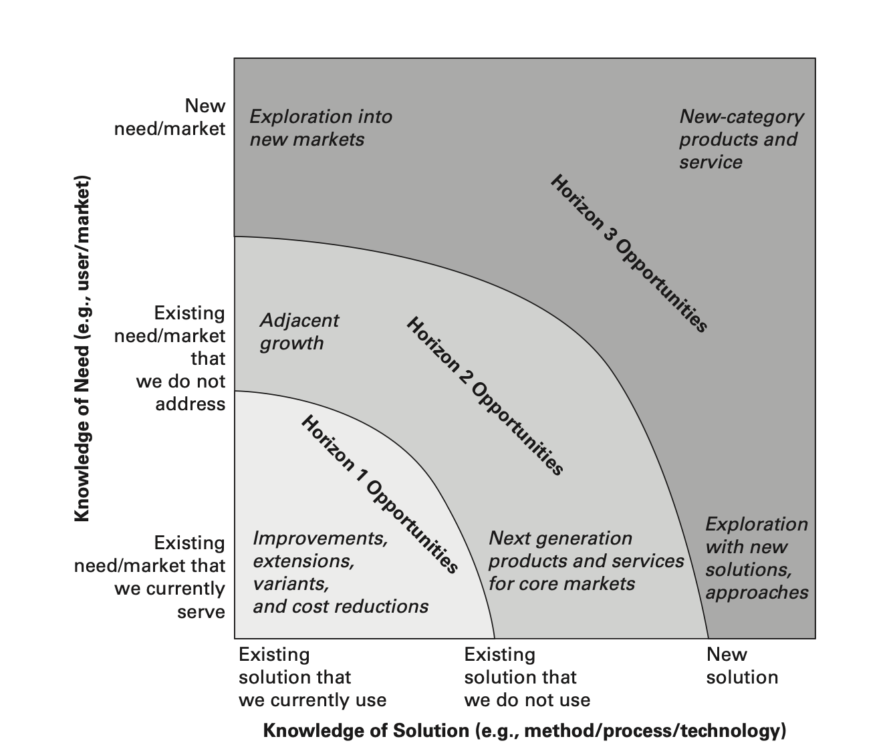
Types of Opportunities
Source: Ulrich & Eppinger
Notes:
Horizon 1 opportunity: Tweaks to our current products / solutions or cost reductions
Horizon 2 opportunity: Push into less known territory on one or more dimensions
Horizon 3 opportunity: Most uncertain, trying to either introduce new technologies to market or solve a new need (or both!)

Slide 6
Opportunity Portfolio
Opportunities are uncertain
What types of opportunities are more / less uncertain?
Useful to develop several ideas in parallel
Initial goal is to generate many opportunities and winnow down as uncertainty is resolved throughout the process

Slide 7
Implications of Uncertainty in Payoffs
Generate many ideas
Increases the likelihood of finding an exceptional idea
Increase variance in ideas
1000 ideas that tweak the color of the website are highly correlated
Payoff of choosing among many uncorrelated ideas higher than payoff of choosing among many correlated ideas

Slide 8
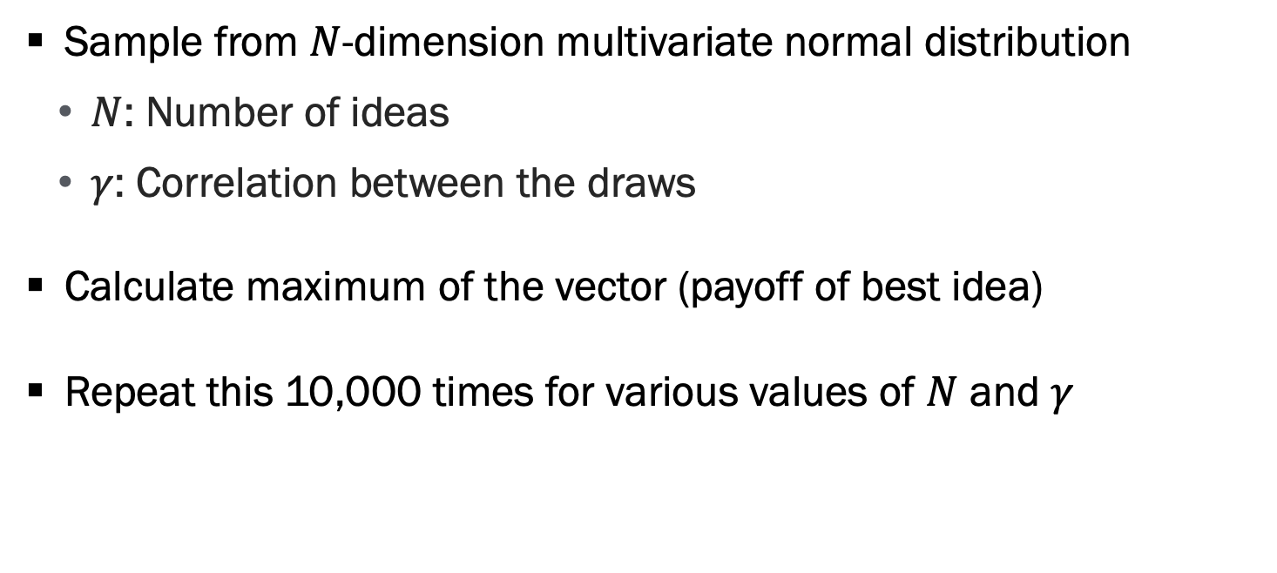
Proof-by-Simulation
Sample from $N$-dimension multivariate normal distribution
$N$: Number of ideas
$γ$: Correlation between the draws
Calculate maximum of the vector (payoff of best idea)
Repeat this 10,000 times for various values of $N$ and $γ$

Slide 9
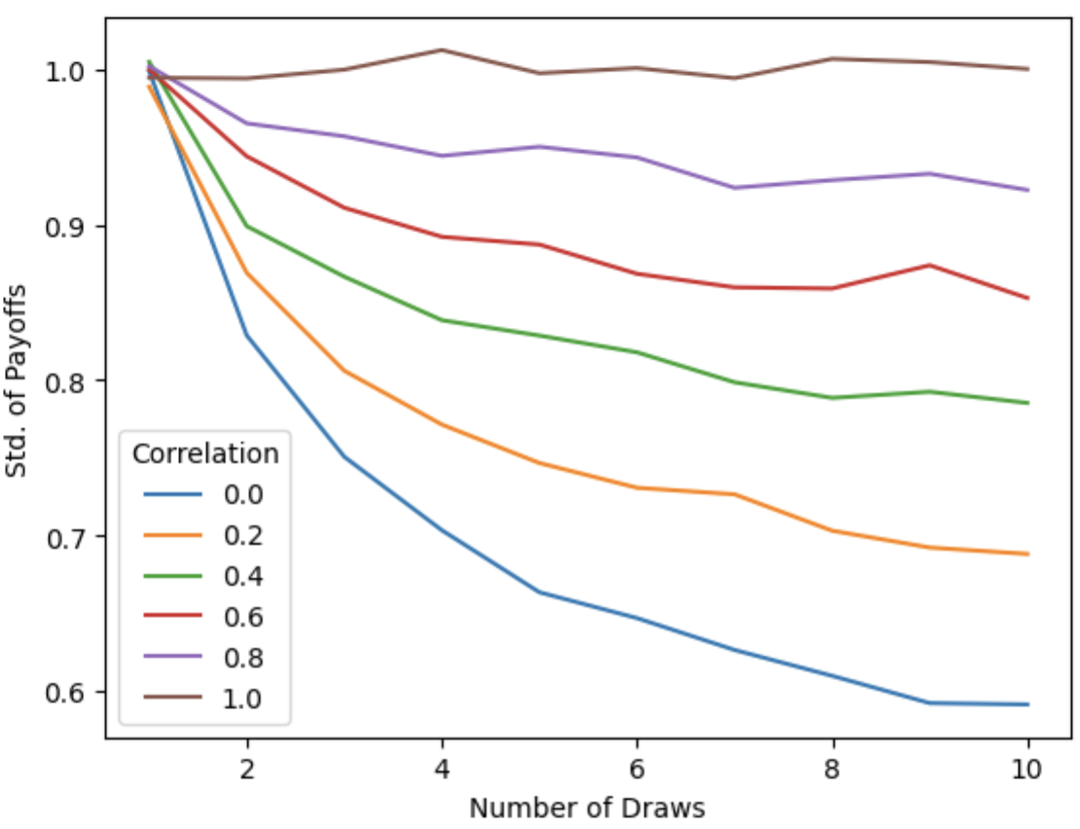
Prefer Uncorrelated Ideas: Traditional Diversification
Notes:
Sample 10,000 draws from MVN distribution with K elements and calculate the max. This plots the standard deviation of the max

Slide 10
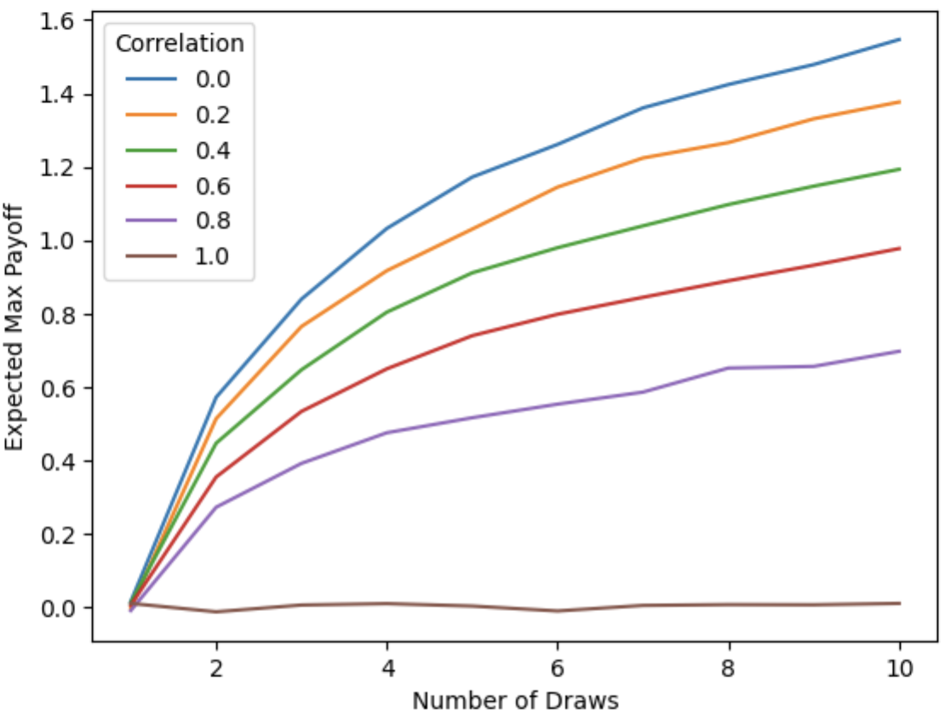
Prefer Uncorrelated Ideas: Order Statistics

Slide 11
Fat-Tailed Distributions
Thin tailed distributions: The average value provides a useful measure of the central tendency
Examples: Height, speed of cars, temperature
“Large” deviations from the mean are rare
Fat tailed distributions: Outlier events are likely and the mean is less useful as a measure of central tendency
Example: Average US city population in 2000 was ~8,000
In digital markets, many examples of fat-tailed distributions

Slide 12
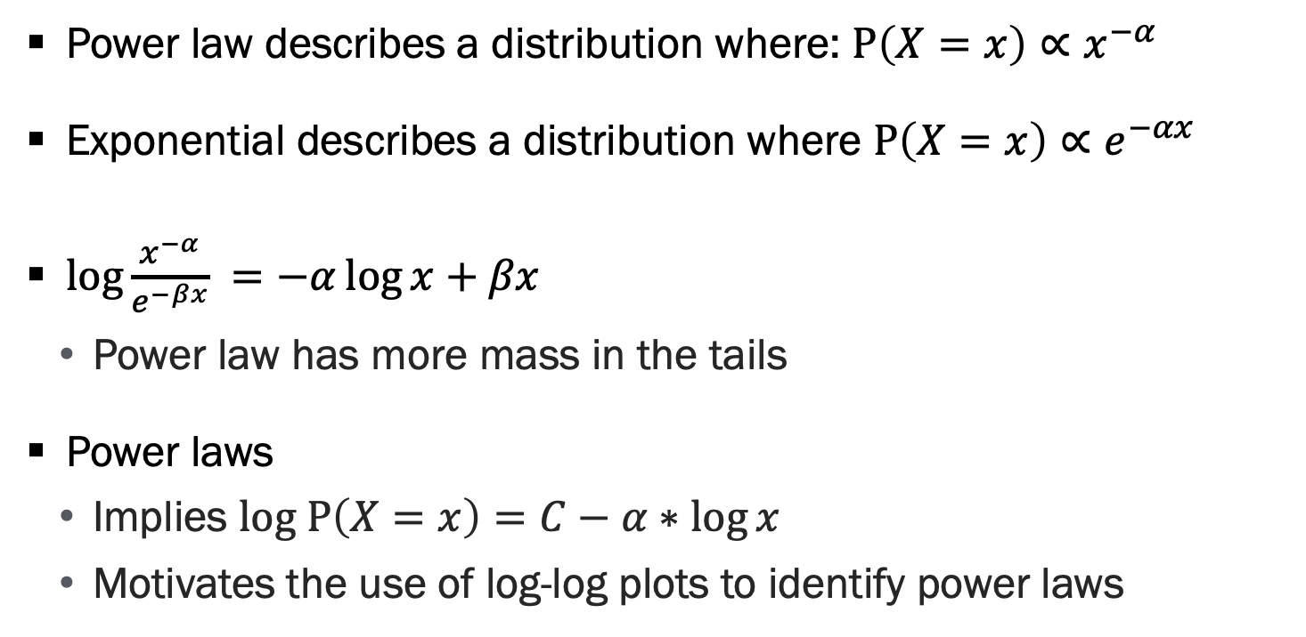
Power Laws and Fat Tails
Power law describes a distribution where: $P\left(X=x\right)∝x^{−α}$
Exponential describes a distribution where $P\left(X=x\right)∝e^{−αx}$
$\log{\frac{x^{−α}}{e^{−βx}}} =−α\log{x}+βx$
Power law has more mass in the tails
Power laws
Implies $log P\left(X=x\right)=C−α∗\log{x}$
Motivates the use of log-log plots to identify power laws

Slide 13
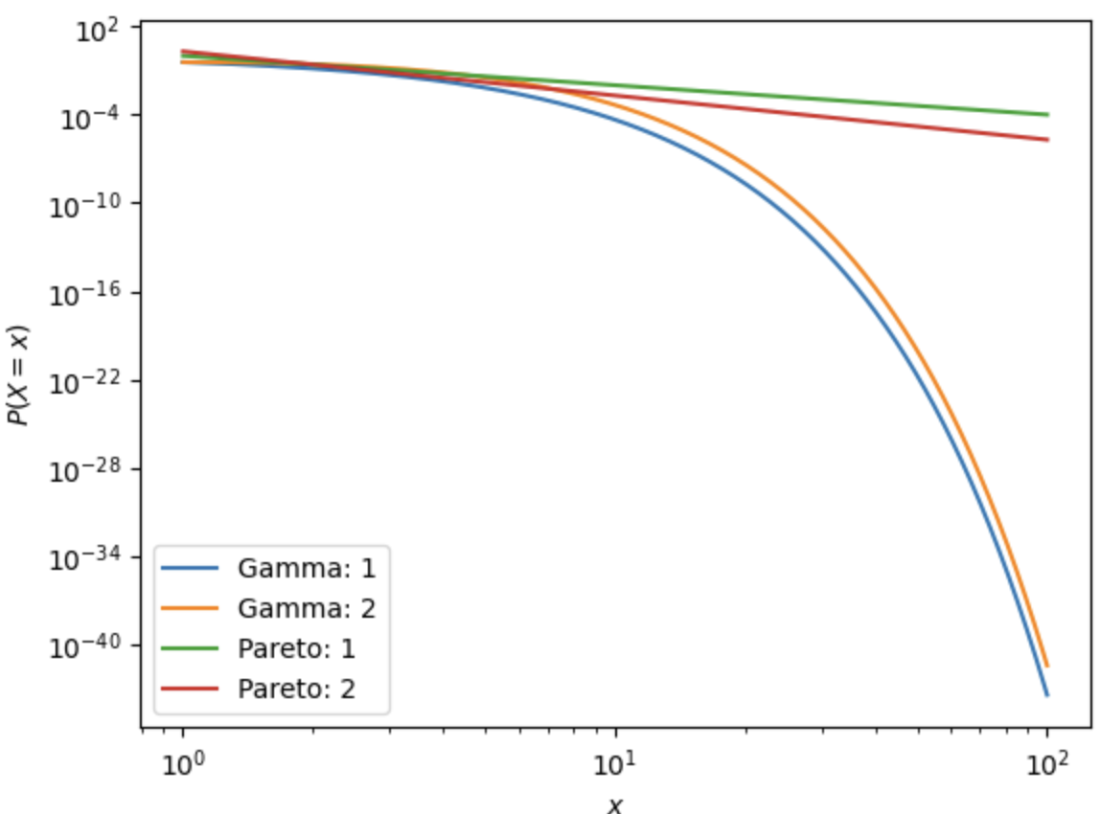
Power Laws and Fat Tails, Continued

Slide 14
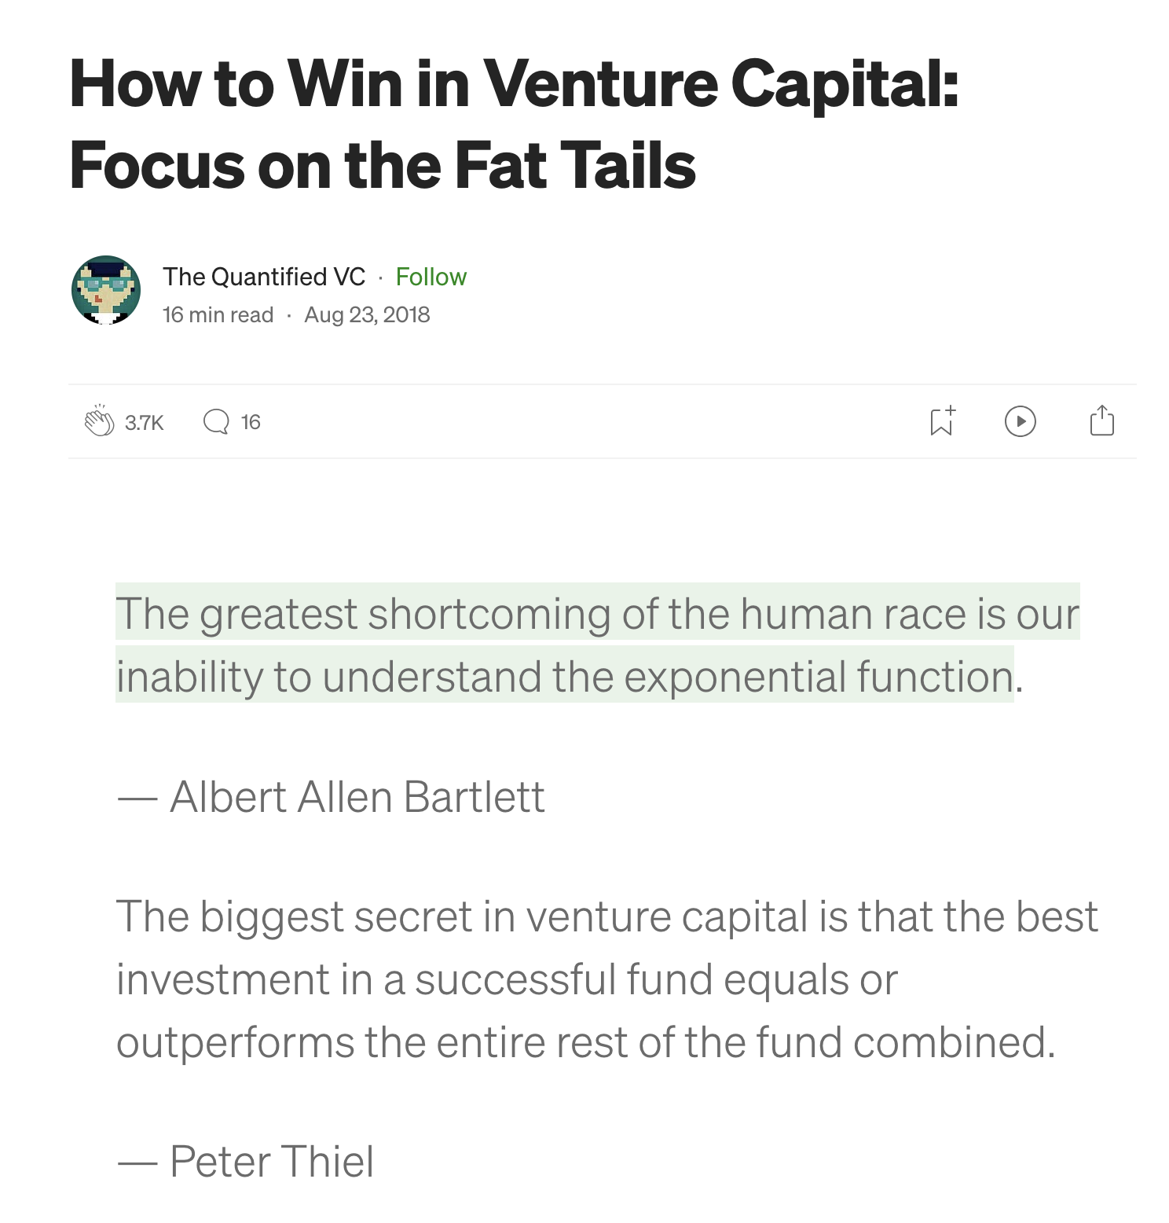
Fat-Tails in Venture Capital
Source: Azevedo et al (2020)
Notes:
This plots

Slide 15
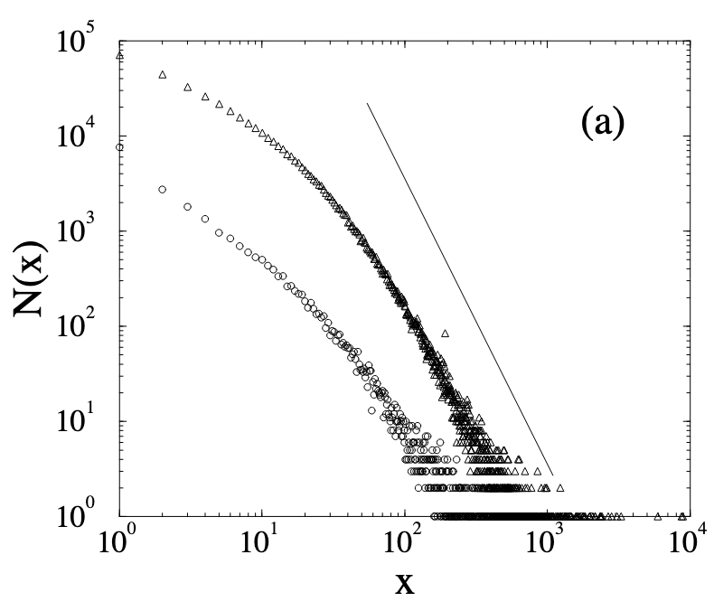
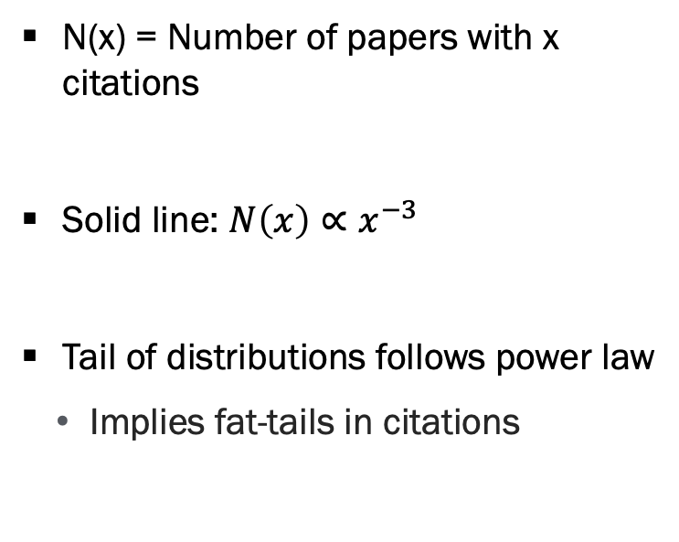
Fat-Tails in Academic Citations
N(x) = Number of papers with x citations
Solid line: $N\left(x\right)∝x^{−3}$
Tail of distributions follows power law
Implies fat-tails in citations
Source: Redner (1998)
Notes:
This plots

Slide 16
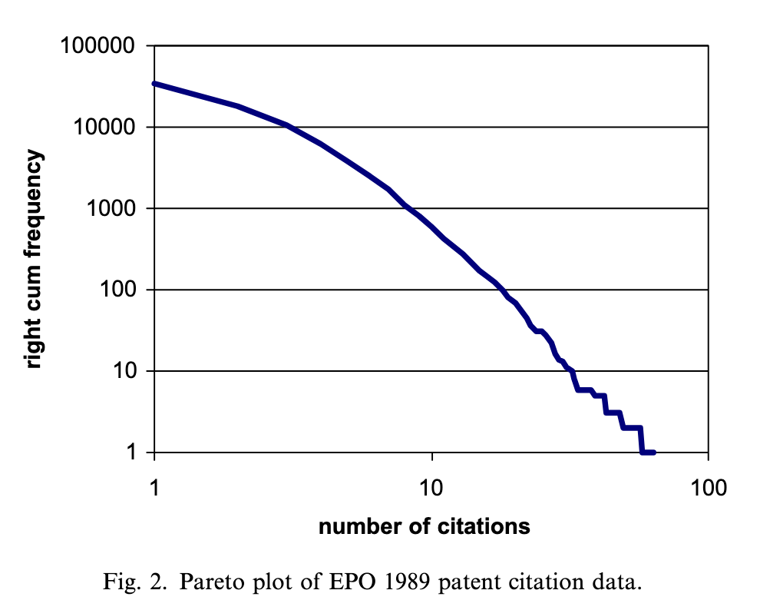
Fat-Tails in Patent Citations
Source: Silverberg & Verspagen (2007)
Notes:
This plots

Slide 17
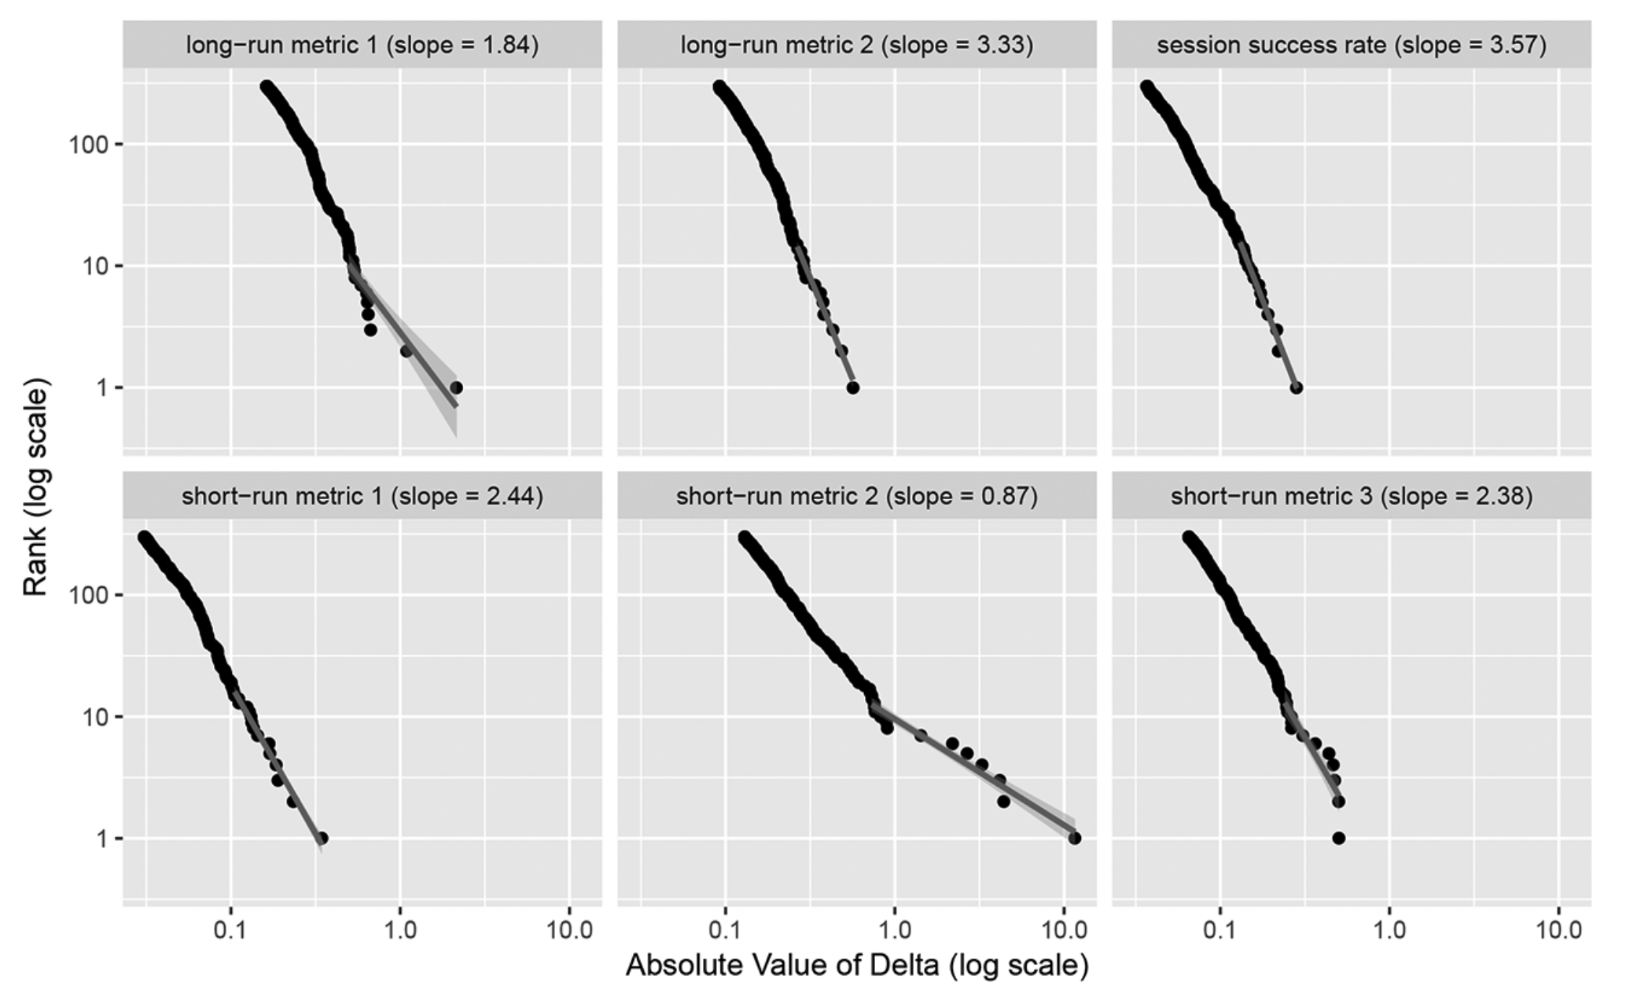
Fat-Tails in Bing Experiments
Source: Azevedo et al (2020)
Notes:
This plots

Slide 18
Takeaways
When your ideas have fat-tailed payoffs, there is a ton of value in identifying the outlier ideas
We prefer uncorrelated ideas to reduce variance of payoff and increase average payoff
Takeaway: Generate many ideas in the ideation process

Slide 19
Opportunity identification process
* Ulrich & Eppinger Chapter 3

Slide 20
Overview of Opportunity Identification Process
Theoretical understanding of this process is limited
Often more art than science
Main understanding is:
Payoffs are uncertain and fat tailed
Implication is to generate and evaluate as many opportunities as possible

Slide 21
Step 1 – Set Boundaries
Helpful to set boundaries for what we’re trying to accomplish
Boundaries should be broad
Type of good (physical / digital good)
Market / problem we to address
E.g. professional networking
Timeline
E.g. Launch within 12 months
A tension between generating many uncorrelated ideas and having a more focused search for opportunities
Often good to err on side of too broad rather than too narrow

Slide 22
Step 2 – Generate Ideas
Draw on personal experiences / passions
Make a list of pain points you encounter in your life
Study customers and identify latent needs
Interview target customer segment (both customers & non-customers)
Dig through bug reports / feature requests
Imitate
Tweak existing innovations, push local innovations global, imitate across industries
Notes:
Examples:
- Study customers: Shimano bikes initially interviewed customers who were avid bikers. They wanted fancier more sophisticated bike components. They eventually interviewed non-customers who prefer simple components, and this opened up a new market for them
- Imitate: Howard Schultz reportedly started starbucks after visiting milan and seeing its café culture

Slide 23
Step 3 – Screen Opportunities
Solicit feedback internally and externally
Vote internally, ask your friends + family
Goal here is to remove opportunities that are not promising
Remove “losers” rather than identify the “winner”
Don’t remove ideas that are polarizing
Strong opinions often suggest a promising opportunity
Be thoughtful with how you aggregate opinions
Anonymous / online voting can encourage participation and expression of diverse viewpoints

Slide 24
Step 4 – Develop Opportunities
Market research & trends
How big is the market? Is it growing / shrinking? What is the competitive landscape?
Interview potential customers
Is there excitement about the opportunity?
Formal survey techniques (e.g. conjoint analysis)
Analyze feasibility
Estimate cost (in dollars and time) of development / production
Is our innovation patentable / proprietary / easily replicable?

Slide 25
Step 5 – Select Exceptional Opportunities
We now have the information needed to identify best opportunities
Many, many, many frameworks that can be applied
One example: Real-Win-Worth it
Is the opportunity real? Does the market exist and will our opportunity address the need in the market?
Can you win? Can you create a sustainable competitive advantage through patents / technology / network effects / know-how?
Is the opportunity worth it financially?

Slide 26
Step 6 – Reflect
Did we do a good job in generating and selecting opportunities?
Do we feel good about the outcomes?
If we’re not excited about the opportunity, who will be?

Slide 27
Project Matching

Slide 28
Project Matching + Ideation
If you have a product you want to use for project, stand at perimeter of class or raise your zoom hand
If online, introduce your product and note the breakout room
Spend 5 minutes talking with each other, forming teams of 4
Work through the opportunity identification process
Set boundaries for the process
Spend 10-15 minutes generating ideas
Cull the ideas to most promising
Develop the ideas (or think about how you would develop)

Slide 29
Share your Ideation Experience
What worked?
How many ideas did you generate?
Are they correlated?
What uncertainty remains?
Do you have a project that you are excited to work on?

Slide 30
Questions

